Slide 2
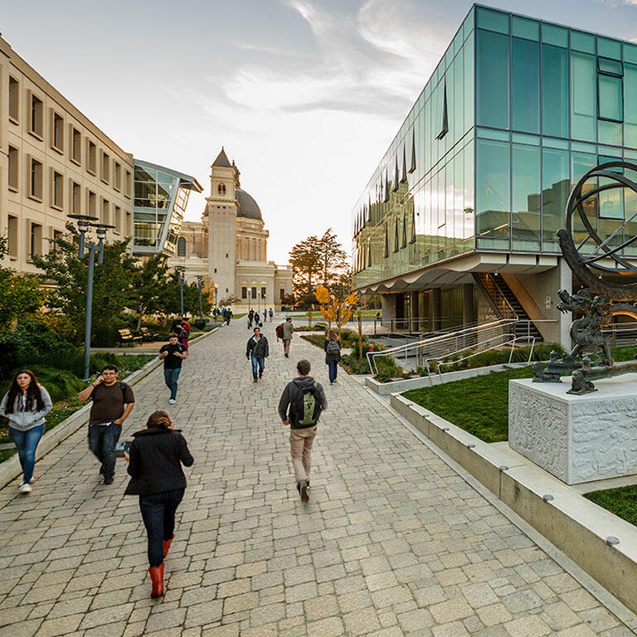

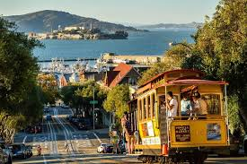
Introductions
Christopher Brooks
Professor, Computer Science
University of San Francisco
Research areas:
Artificial Intelligence
Machine Learning
Multiagent Systems
Social and Ethical Uses of AI

Slide 3
Introductions
Tell me about yourself!
Name
Major or area of study
Where are you from?
Experience with AI

Slide 4
So what’s this class about?
Chance to discuss the ways that AI is changing our world.
Potential concerns and harms
Positive futures – how can we articulate the world we want to live in?

Slide 5
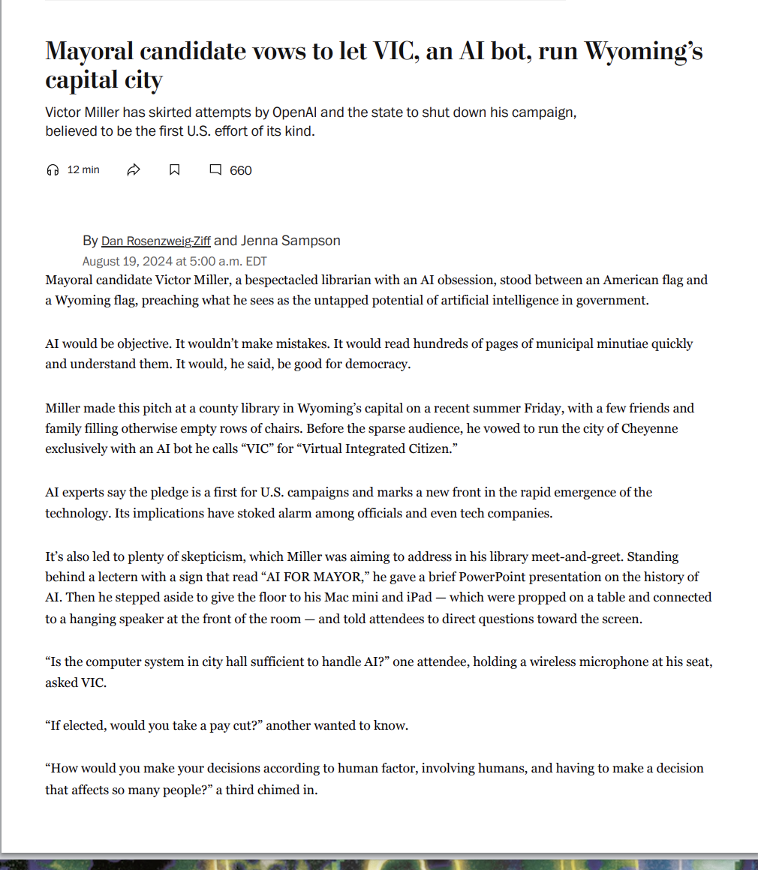
News Article: Can an AI be Mayor?
This sounds silly, but …
Is there a place for AI in understanding complex local ordinances?
Where do we distinguish between advising and making decisions?
How do we handle responsibility in AI-driven systems?
What’s the role of AI in politics?

Slide 6
Ubiquitous computing
Computers are everywhere. Almost everything is a computer.
Where have you interacted with a computer today?
Today, many of these computers are networked.
What are some things that are not classic computers that are networked?

Slide 7
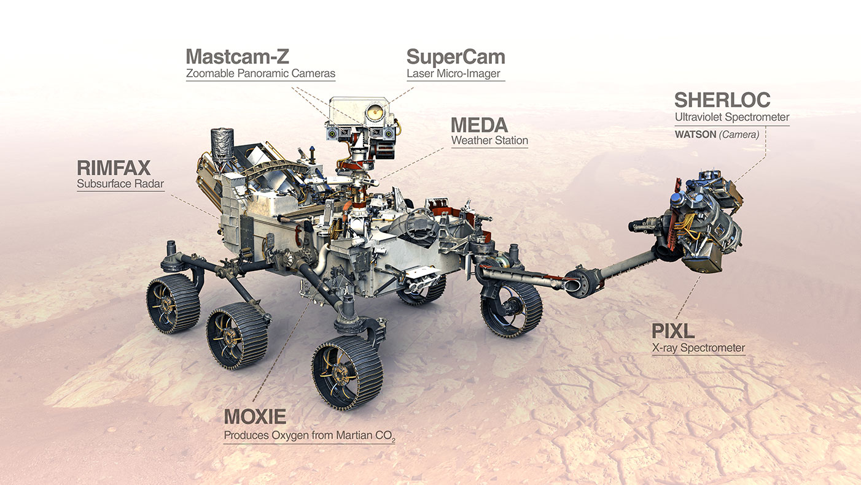
State of the Art
The Perseverance rover has been operating semi-autonomously on Mars since 2020.
It has AI systems to help it navigate, perform experiments, evaluate data, and plan complex sequences of actions in a very complex and unforgiving environment.
Perseverance

Slide 8
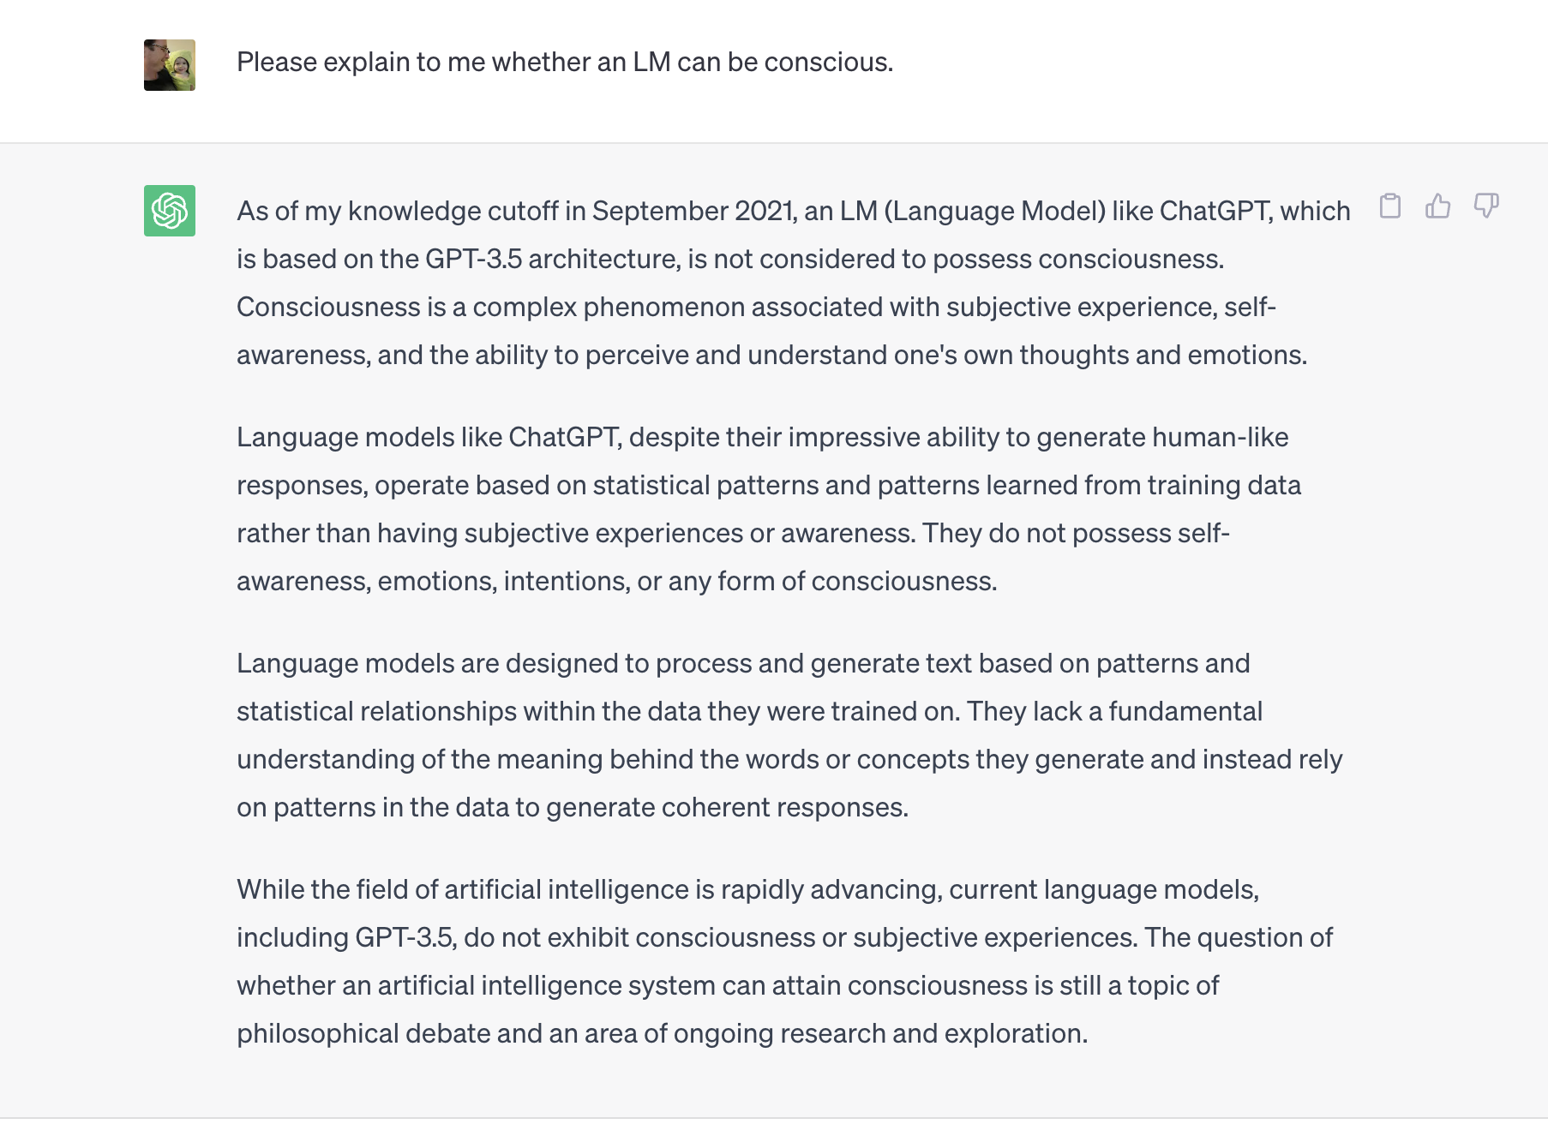
State of the Art
ChatGPT is the most well-known of a set of Large Language Models (LLMs).
An LLM is a program that learns statistical patterns in a corpus of documents, and then generates novel strings of words consistent with this pattern based on a prompt.
They illustrate what can be done with a vast amount of data and computing power, and also how easily humans are fooled.
ChatGPT

Slide 9
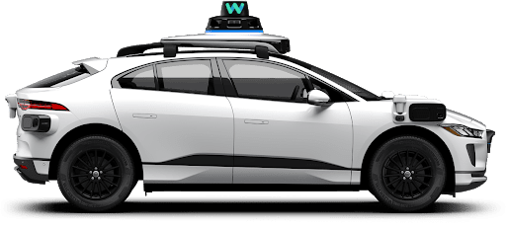
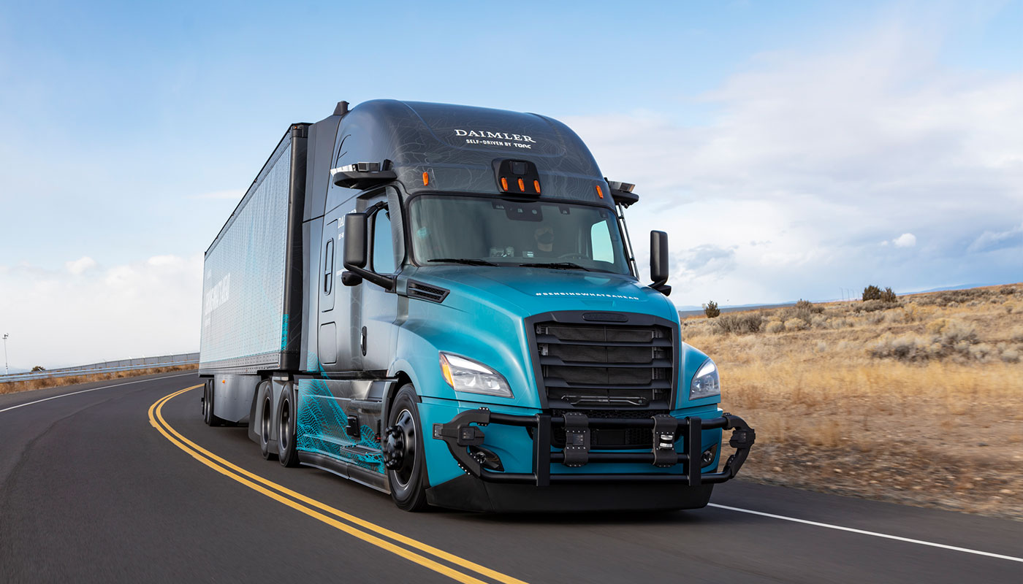
State of the Art
Autonomous and semi-autonomous vehicles have made rapid improvements in capability and practicality.
These vehicles have a complex set of AI systems for:
Tracking the road, lane following, collision detection
Pathfinding
Long-term planning
Interfacing with human systems.
It is this last part that is the most challenging.

Slide 10
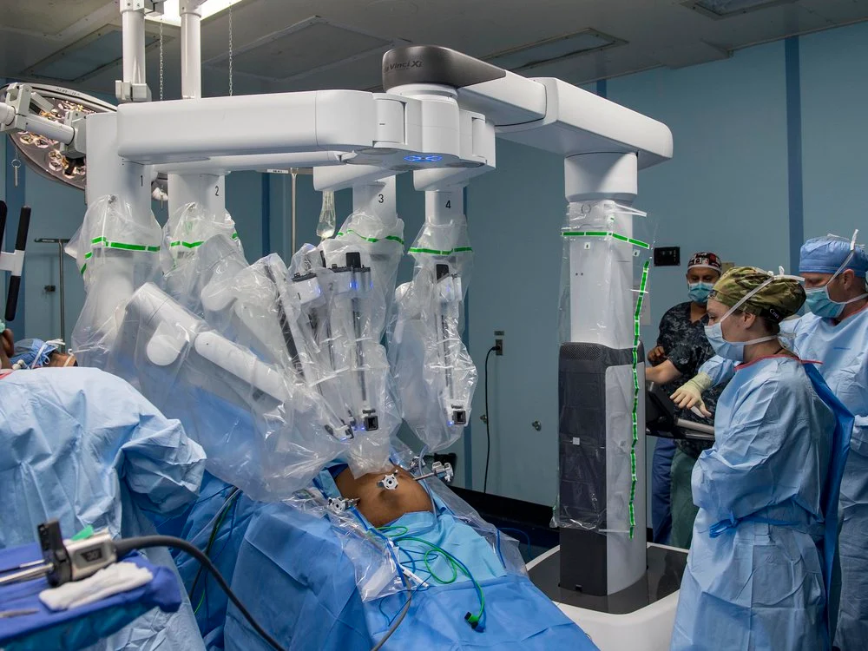
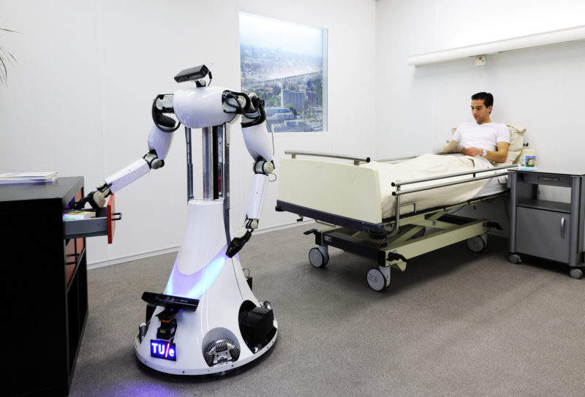
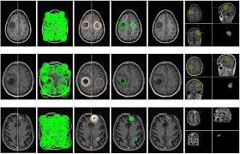
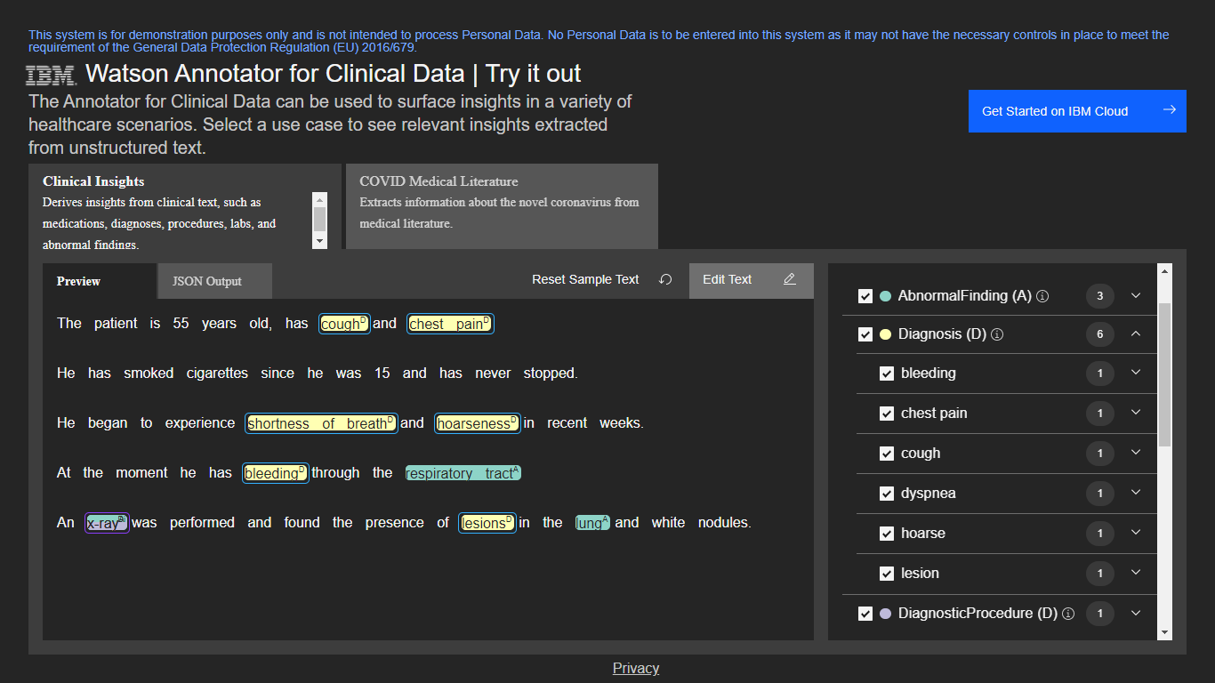
State of the Art
AI is being widely used in precision medicine to automatically detect tumors, assist with and perform surgery, integrate patient data, and perform routine patient care.
These tasks are each very specialized, and require different, very focused skills.

Slide 11
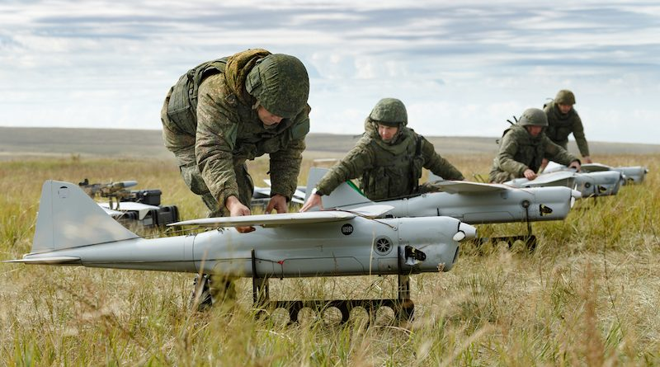
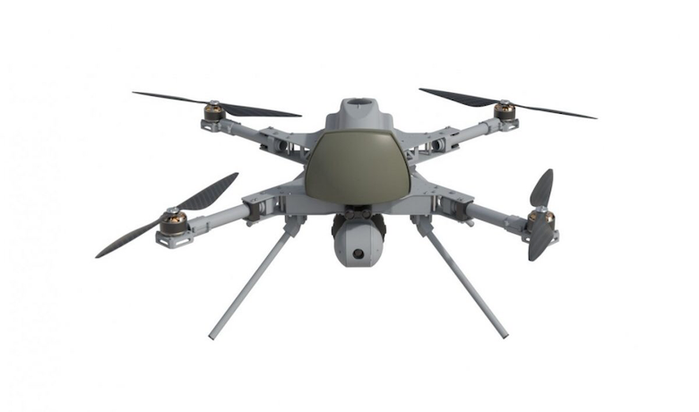
State of the Art
The current wars in Ukraine and the Middle East have intensified the development of inexpensive drones with AI capabilities.
These systems are capable of identifying targets, pursuing them, and avoiding counterattack without human intervention.
They are very inexpensive to build; the components can be purchased online.
This has raised a host of complex questions about the role of technology in warfare.

Slide 12
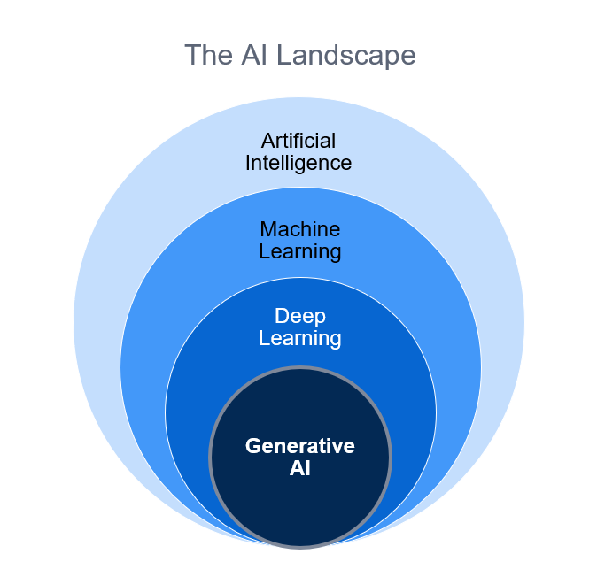
Terminology
AI: This is a broad set of technologies intended to “do things that require intelligence when people do them”
Flying a spacecraft, driving a car, writing an email
ML: Programs that can improve performance over time.
Often through finding patterns in large datasets.
Deep learning: A particular AI architecture
Good at finding complex patterns in huge datasets.
Generative AI: using AI tools (often deep learning) to generate novel outputs.
The transformer is the key idea.
Large Language Models: A deep learning system trained on a huge collection of documents.
Learns a statistical correlation between words.

Slide 13
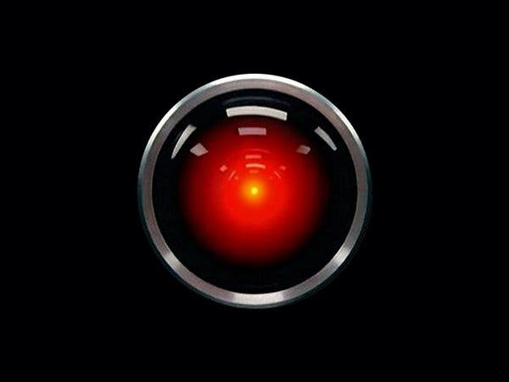
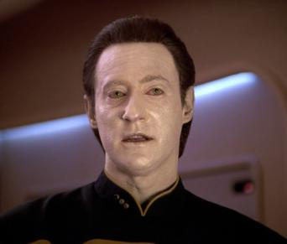
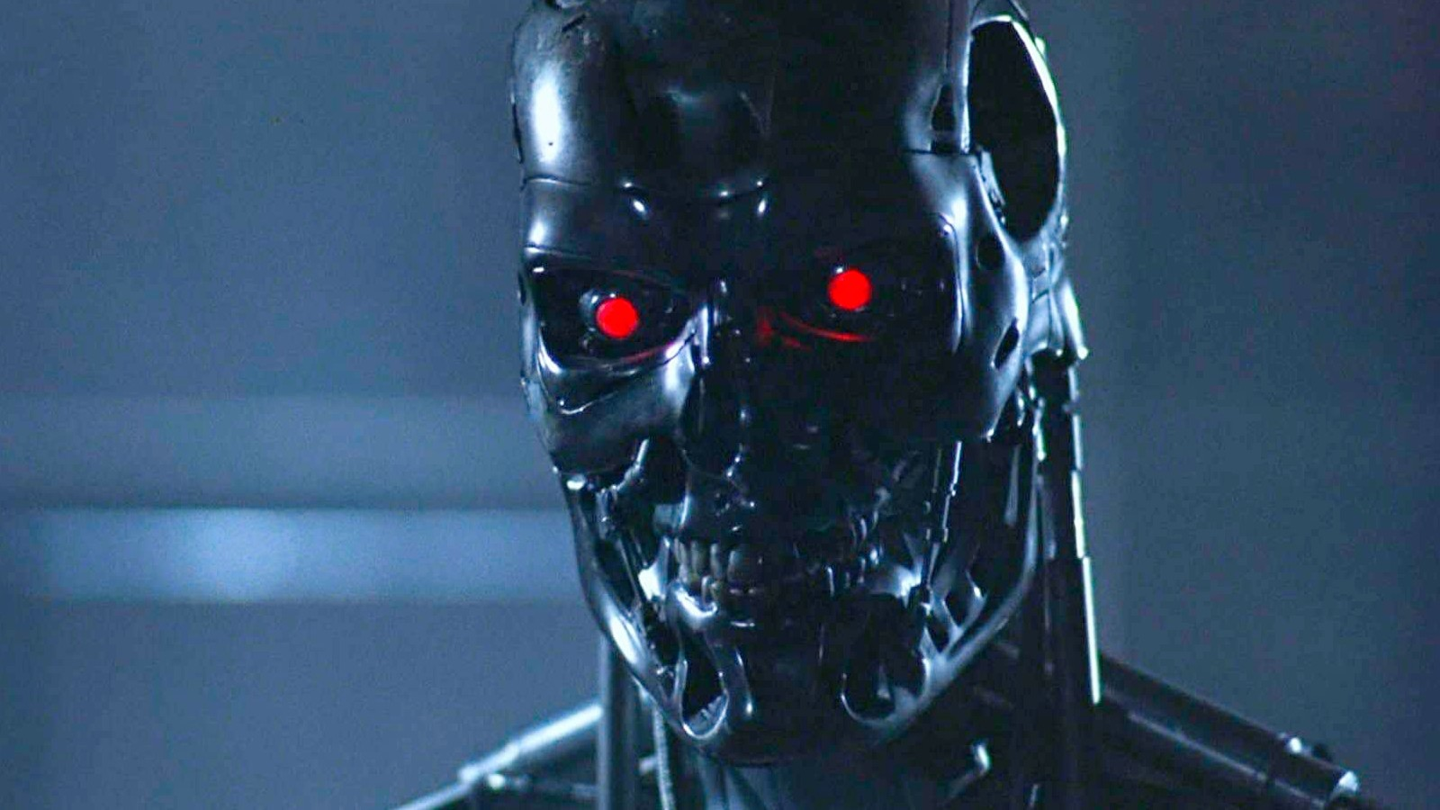
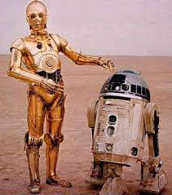
What AI is and is not
In popular fiction, AIs typically have human-like personalities, motivations, and abilities.
This makes for great drama, with relatable characters, but it not very realistic.
These characters have an extremely rich and varied set of skills and capabilities.

Slide 14
What AI is and is not
Current AI systems are “intelligent” only with respect to a particular domain of expertise.
Face recognition, text generation, data analysis.
They do not have:
Self-awareness
The ability to solve a broad set of problems
ChatGPT cannot drive a car …
Life-long learning
We don’t need to worry about killer robots taking over.
There are other concerns that are more pressing!

Slide 15
What’s In a Name? Intelligence and Learning
Dartmouth, 1956: “…how to make machines use language, form abstractions and concepts, solve kinds of problems now reserved for humans, and improve themselves.”
Intelligence and learning are defined behaviorally – based on the ability to solve specific tasks or demonstrate improvement.
Since 1956, we’ve realized that emulating human behavior is sometimes useful, but sometimes we need to avoid human biases or weaknesses.

Slide 16
Issues and concerns
What are some concerns that might be raised about AI?

Slide 17
Issues and concerns
What are some concerns that might be raised about AI?
Bias
Disinformation/misinformation
Robot takeover
Unintended consequences
Loss of jobs
Copyright, piracy, plagiarism
Data loss, leakage
Fraud
Warfare

Slide 18
Possibilities
What if we place humans at the center of the process here?
What if AI was used to augment human capabilities? What might we develop?

Slide 19
Possibilities
What if we place humans at the center of the process here?
Human-centered AI
What if AI was used to augment human capabilities? What might we develop?
Assistive technologies
Medical applications
Tools for addressing climate change
Tools that automate drudgery
Tools that do risky or dangerous work
Tools that help us organize our lives

Slide 20
Hope-filled future
The Jesuits talk quite a bit about cultivating a “hope-filled future” in young people.
actively and resiliently working towards a better world based on faith, justice, and solidarity, even in the face of challenges.
It's not naive optimism but a commitment to good, and to a more just and sustainable future.
Notice the action words here. The future is hope-filled because we consciously work to make it so.

Slide 21
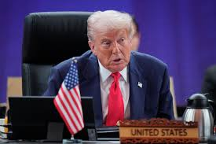
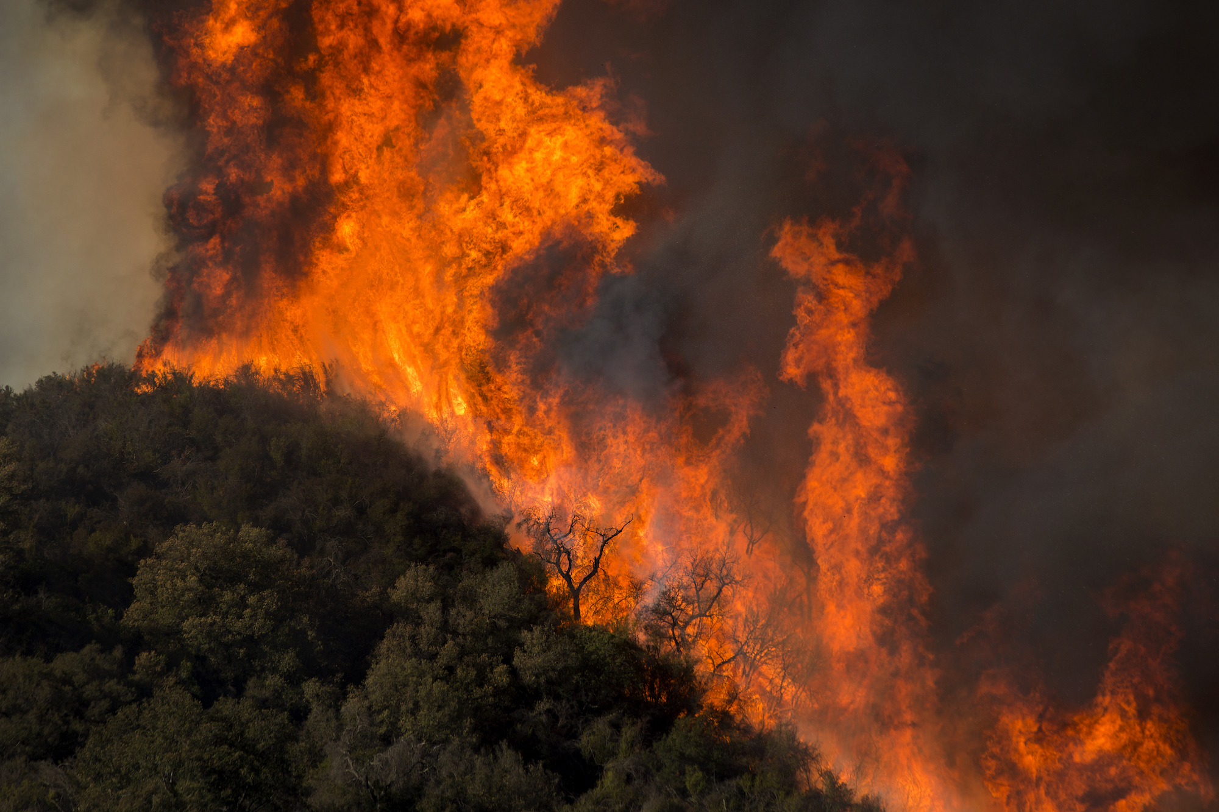
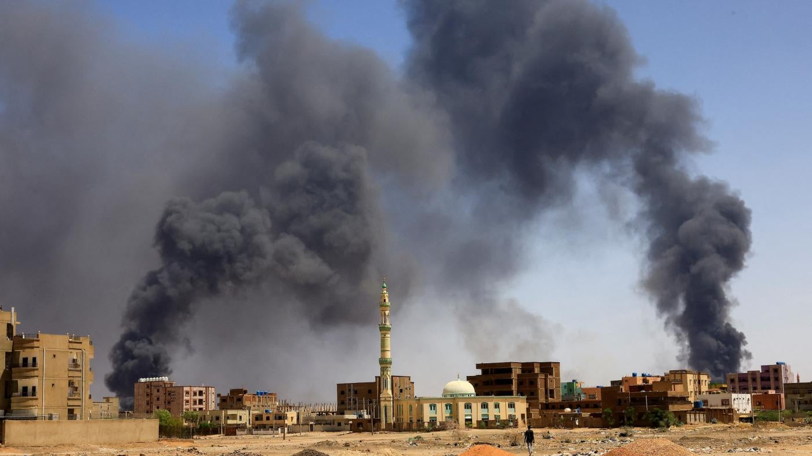
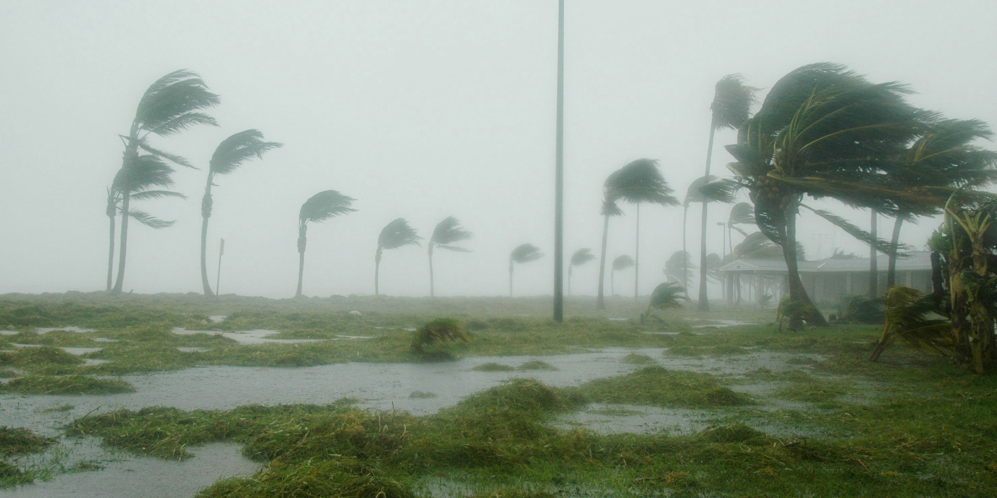
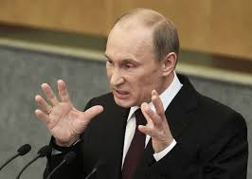
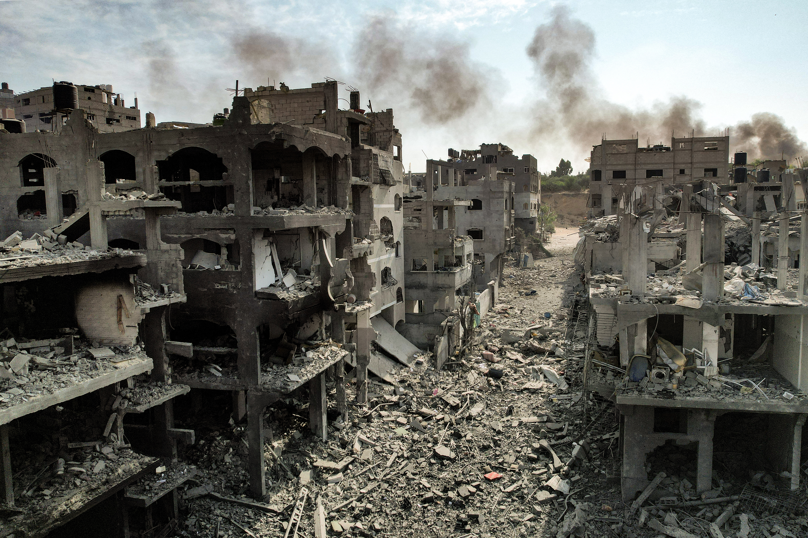
Hope-filled future?
It seems hard to be optimistic these days.
How do we find hope?
How do we imagine and create positive futures amidst all of this?

Slide 22
Utopia and dystopia
Often in pop culture, AI is presented as part of a dystopia.
This can color both our vision of AI and what is possible.
Sometimes, it’s useful to imagine what could be – a utopia.
Some of us live a utopian life by 19th century standards
But those benefits are not distributed equally
AI and automation could either correct or exacerbate inequality.
So what does our utopia look like? What is the world we dream of?

Slide 23
Not techno-utopianism!
There is a school of thought that says that technology will solve all our problems.
All innovation is good. Technological progress is valuable for its own sake.
This is both wrong and dangerous.
Pope Francis: Laudato Si: “[the problem] is the way that humanity has taken up technology and its development according to an undifferentiated and one-dimensional paradigm ” in which unlimited growth is the only goal.
“We have the freedom needed to limit and direct technology; we can put it at the service of another type of progress, one which is healthier, more human, more social, more integral.”
This leads us to the consideration of human-centered AI.

Slide 24
Optopia
Utopian thinking is often (rightly) criticized for being unrealistic.
The novel Utopia was actually a parody of this sort of approach.
How can we be forward-looking while still recognizing path dependencies?
That is, we cannot erase our past, and we can only move forward from where we are.
Some decisions are already ”baked in”

Slide 25
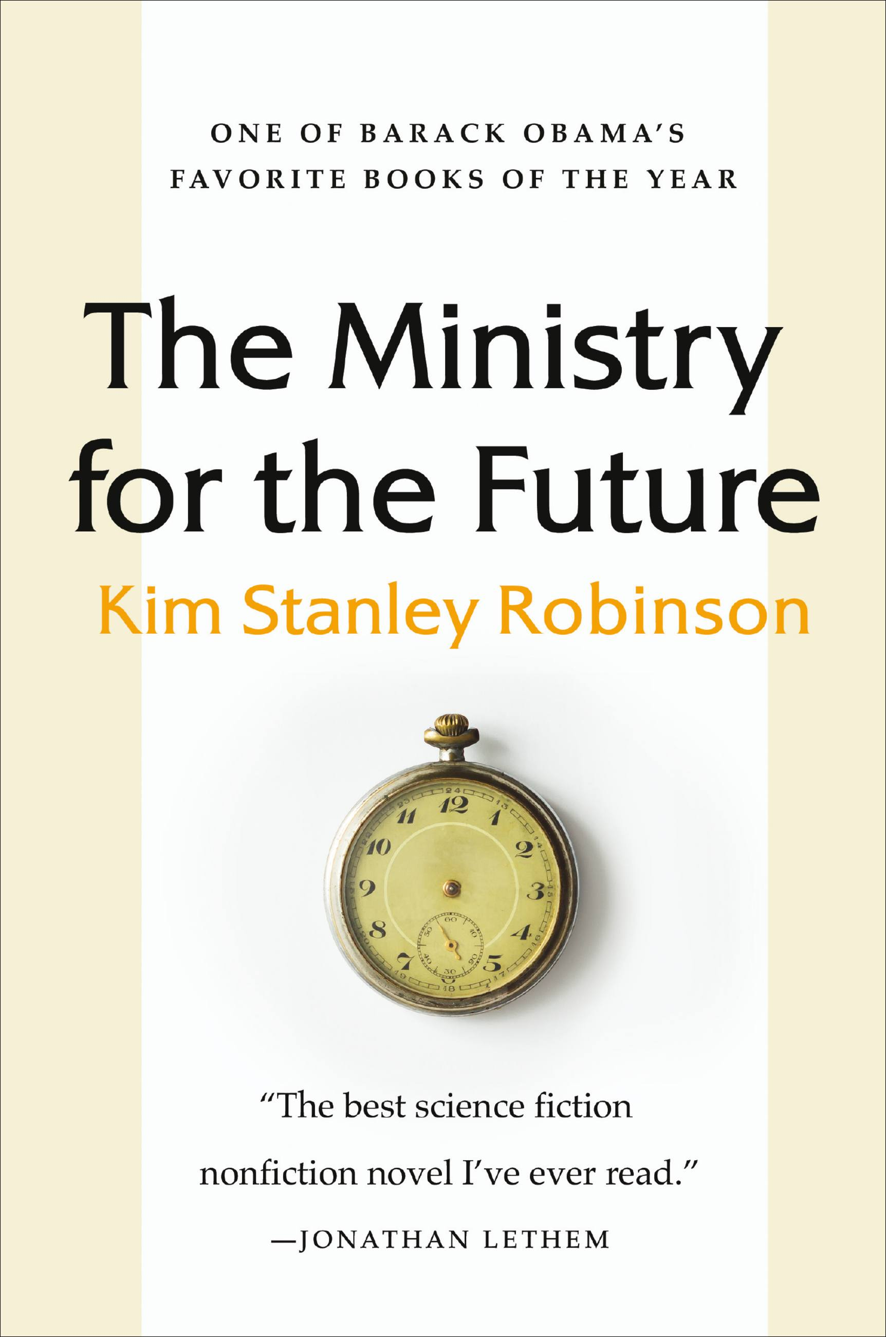
Optopia
Kim Stanley Robinson’s The Ministry for the Future is an optopia about climate change in the 21st century.
“In Ministry, I set out to imagine a positive history that gets us to a better state…. We have a moral obligation to find that optopia. The present moment sets some harsh constraints. We have entered an era of climate change that imposes radical physical stresses on both human and natural systems. We are caught in a technological and cultural path dependency, and we can’t easily change course … So, it’s possible to freak out. But if you’re in a race—an intense race, with high existential stakes, which you might win or you might lose – then it is not the time to give up. You actually have to race harder; you have to make the effort to win the race. You can give up if you lose, but in the meantime, in this decade, it’s not appropriate to give up, particularly since so many people in much less privileged positions than you and I are doing their damnedest to cope with the situation that we’re in. Hope, therefore, becomes a political position. … Given our situation, I would recommend being fueled by dread, but also buoyed, and kept focused on the necessary work, by willed hope, as a political position. “

Slide 26
Optopia
As we talk about AI over the next two days, we’ll return to this idea:
What is the world that we want to live in? How can we get there from here?
Note that that’s different from just critiquing; we certainly have to critique, but we also need solutions.

Slide 27
break

Slide 28
Hidden Bias
A classic problem in machine learning is the introduction of hidden bias.
All learning algorithms have some sort of bias in them; this governs how they categorize new data.
Some biases are benign – prefer the simplest or most common answer.
Others are not, and can produce harmful results.

Slide 29
ML in two minutes
Machine Learning is the problem of automatically finding patterns in data. Ideally these patterns are predictive or explanatory.
This usually involves identifying features that we want to measure (such as address, age, or name) and classifications that we want to predict (such as income).
By looking at lots of labeled data (where the outputs are present), we are able to predict classifications for unlabeled data.

Slide 30








Classification
Many common machine learning tasks are classification tasks.
“Obi-wan”
“Katniss”

Slide 31
Classification
We might want to:
Tell them apart
Label photos
Control a food dish
“Obi-wan”
“Katniss”

Slide 32


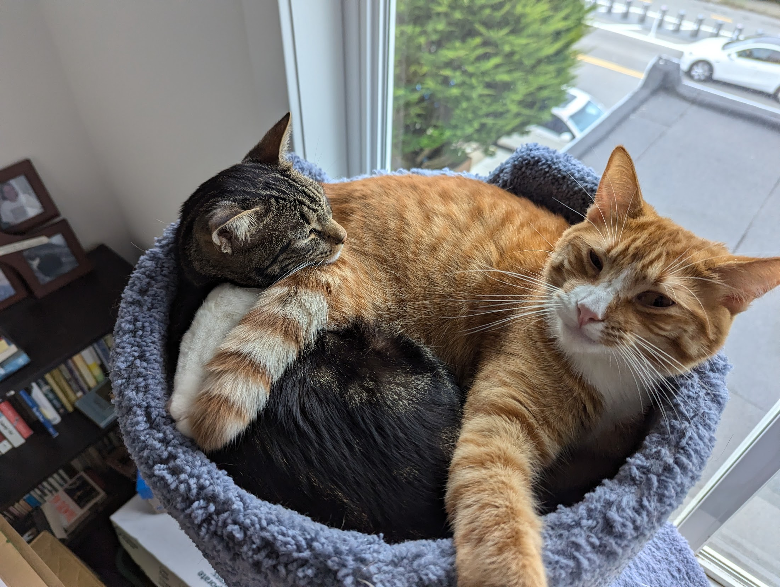
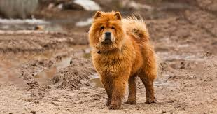
Classification issues
So what happens when the classifier sees:

Slide 33
Classification issues
So what happens when the classifier sees:
It depends!
In answering this question, we
introduce bias.

Slide 34
Bias
Bias is a complicated term.
It can mean prejudicial bias
Treating individuals unfairly or making judgments based on irrelevant characteristics.
It can also mean inductive bias.
How does a human or a program reason from specific-to-general?
Given some pictures of a cat, is this new picture the same cat?
In real life machine learning problems, they often interact.

Slide 35
COMPAS
COMPAS is a system that was designed to reduce bias, but inadvertently amplified bias instead.
Excellent case study.
Problem to be solved: How can we minimize the number of people unfairly jailed while awaiting trial?

Slide 36
COMPAS
In the US, judges decide whether to hold people awaiting trial.
Potential for human bias.
Bail is a common tool, but is unfair to defendants without money
Could we build a tool that predicts whether someone is a "good risk"?
Challenge: How do we measure risk?

Slide 37
Building COMPAS
Take a past dataset of people who were arrested.
Look to see whether, if freed, they were re-arrested.
Try to learn characteristics (age, severity of crime, number of arrests) that predict being rearrested.
Assumption: our past dataset is well-constructed, measures the right things, and is truly predictive.
Assumption: the future is like the past.
Observation: any biases in our dataset will be reflected in our learner.

Slide 38
Fairness
Fairness is a core concept in American justice.
It means that the law should apply equally to everyone.
We cannot have two standards, or different rules for different groups.

Slide 39
Accuracy
Accuracy is also a core concept in machine learning.
The tool should minimize the number of people who are misclassified.
In particular, people should not be needlessly jailed.
This is also a core concept in American justice.

Slide 40
Balancing fairness and accuracy
So why was this a problem for COMPAS?
It’s not possible to pick a single threshold across groups that minimizes the number of false positives (people needlessly jailed.)
Note that this is not specific to COMPAS – this will be true for any algorithm when working with this data.

Slide 41
Biased data
What is the core problem underlying the data that COMPAS uses?

Slide 42
Biased data
What is the core problem underlying the data that COMPAS uses?
COMPAS was trained using data from Broward County.
Historically, 52% of Black defendants were rearrested.
39% of white defendants were rearrested.
But wait! I thought that COMPAS couldn’t use racial data?

Slide 43
Implicit bias
Even though COMPAS is not using racial data directly, it is using other data that can correlate with race.
ZIP code, income
If there is an underlying bias in the data, an algorithm will find it.
In Broward County, minority neighborhoods are more heavily policed, and disproportionately targeted.
This is an example of systemic racism.
The individuals involved may or may not be prejudiced, but the system as a whole definitely is.
The problem is not with the COMPAS algorithm, but with the data it’s trained on.
Human-generated data reflects human prejudices.

Slide 44
Amazon hiring
In 2015, Amazon wanted to develop a tool to better identify promising candidates.
They get a lot of applications, and might want to avoid bias in hiring managers.
Insight: Who is currently thriving at Amazon? What are their qualities?
Remove characteristics for race and gender.

Slide 45
Amazon hiring
The tool wound up not working.
Selected for men.
Downgraded the presence of phrases like “Women’s X” on CVs.
How did this happen?
Amazon’s workforce data already contained bias.
Skewed towards men from elite universities.
So “high performers” were more commonly men from these same universities.
Even though gender was excluded, majors like CS and Physics that skew male, and “male” verbs like “executed” and ‘captured’ were correlated with success.
Problem: their training set did not reflect the hypothesis they were hoping to capture.

Slide 46
Face recognition
This has been an ongoing problem for companies like Google and Microsoft that are developing face recognition systems.
We can think about two different types of face recognition tasks:
Is this me or not?
Two classes, yes or no.
Who or what is this?
Potentially many classes. Still a set number, though.

Slide 47
Face recognition
Many face recognition systems have had problems with the first task (is it me or not) when working with darker-skinned faces.
Models were trained using a collection of photos in which light-skinned faces were overrepresented.
More troublingly, image classification systems have mistakenly labeled pictures of Black people as gorillas.(!)
What’s going on there?

Slide 48
Image classification
How does this work?
The learner has lots and lots of labeled images.
Each label is a class.
New images are assigned a label based on similarity.
No image understanding – just pattern recognition.
What if certain faces are missing?
What if the labeling is incorrect?

Slide 49
Constructing training sets
Constructing a truly representative training set can be really challenging.
Internet data is messy and full of human bias.
You need to really understand all of the latent variables underlying your data.
Often, this is an iterative process.

Slide 50
Proprietary software
Why does it matter that COMPAS was developed by a private company?

Slide 51
Proprietary software
Why does it matter that COMPAS was developed by a private company?
Their algorithm is a trade secret.
No way for a third party to evaluate that it is correct or unbiased.
A judge is unable to ask the system why it gave a particular person the score they received.
Open protocols are a core feature of successful, transparent systems.
Independent experts can verify that a system is working as intended.
Unintended consequences can be identified.

Slide 52
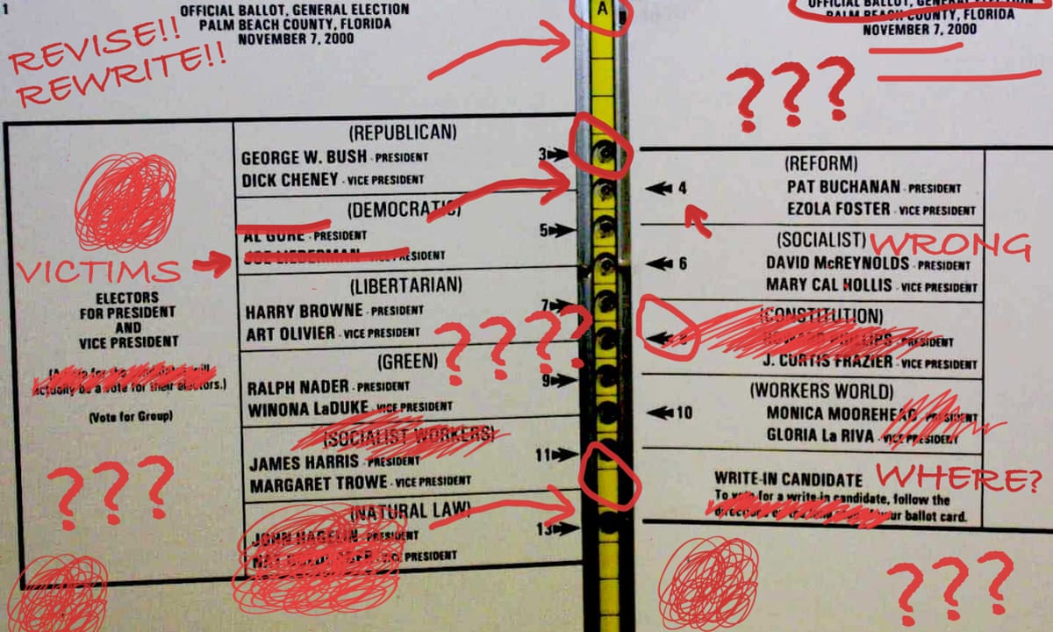
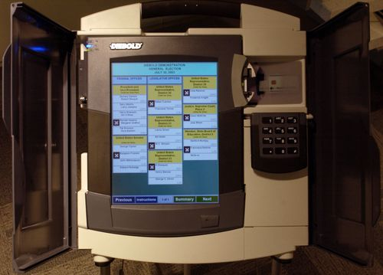
Proprietary software: voting machines
This was a huge problem after the 2000 election.
Problems with hand-marked ballots led to a call for modernization.
Georgia responded quickly by contracting with Diebold to build an electronic voting system.
The system that was developed had significant problems
Hard to use
No paper trail
Easily hacked
Diebold also did not follow best practices
Internal operating was kept secret
Diebold was awarded the contract without competition.

Slide 53
Question:
Suppose that the SF District Attorney hired you as a consultant. They want to eliminate cash bail. They are considering developing a system like COMPAS as an alternative. What would you recommend to them?

Slide 54
Question:
The DAs office has decided that they like the idea of a system for assigning risk to defendants, but they want more human oversight, so the system will act as an assistant in helping judges decide whether to hold defendants awaiting trial.
You've been hired onto a team of engineers developing this system. What steps will you take to avoid some of the problems that arose with COMPAS?

Slide 55
Discussion
Let’s bring it back to the idea of optopia.
Moving forward, what sorts of changes can we work toward to avoid these problems?
What would you recommend to the SF District Attorney in order to not just avoid harm, but also make a positive improvement?
Are there places in this problem where AI can make a positive difference?

Slide 56
lunch

Slide 57
How do we imagine AI?
What are all of the AI characters you can think of in popular media?
Books, TV, movies, music, games, etc

Slide 58
How do we imagine AI?
What are all of the AI characters you can think of in popular media?
Books, TV, movies, music, games, etc
Break them into heroes, villains, and both/neither.

Slide 59
How do we imagine AI?
What are all of the AI characters you can think of in popular media?
Books, TV, movies, music, games, etc
Break them into heroes, villains, and both/neither.
What are the qualities that each group has in common?
Roles? Characteristics? Features?

Slide 60
How do we imagine AI?
What are all of the AI characters you can think of in popular media?
Books, TV, movies, music, games, etc
Break them into heroes, villains, and both/neither.
What things are missing from this list of features?
What roles and characteristics are not present?

Slide 61
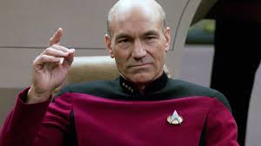
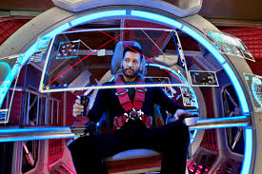
How do we imagine AI?
What are examples that you can think of where AI is present in the story, but is not a character?

Slide 62
How do we imagine AI?
What are examples that you can think of where AI is present in the story, but is not a character?
Group them into positive, negative and mixed.

Slide 63
How do we imagine AI?
What are examples that you can think of where AI is present in the story, but is not a character?
What sorts of roles does AI have here? What capabilities does it have?

Slide 64
Feedback loops
The ways in which we think about technology influence the sorts of technology we create.
We can’t build what we can’t imagine.

Slide 65
Worldbuilding
The Future of Life Institute sponsored a worldbuilding contest to encourage writers, artists, scientists, and others to imagine a world in which AI has a positive influence.
Has to be plausible and aspirational.
Consists of:
A timeline of events to 2045
2 “day in the life” stories
13 answers to prompts about the world
1 media piece

Slide 66
Rules
The year is 2045.
AGI has existed for at least 5 years.
Technology is advancing rapidly and AI is transforming the world sector by sector.
The US, EU and China have managed a steady, if uneasy, power equilibrium.
India, Africa and South America are quickly on the ride as major players.
Despite ongoing challenges, there have been no major wars or other global catastrophes.
The world is not dystopian and the future if looking bright.

Slide 67
Question:
How did humanity address the many challenges it faces?
Not utopian, but aspirational. (optopian?)

Slide 68
Prompts
3.6 What is a major problem that AI has solved in your world, and how did it do so?
3.7 What is a new social institution that has played an important role in the development of your world?
3.8 What is a new non-AI technology that has played an important role in the development of your world?
3.9 What changes to the way countries govern the development and/or deployment and/or use of emerging technologies (including AI), if any, played an important role in the development of your world?
3.10 Pick a sector of your choice (education, transport, energy, communication, finance, healthcare, tourism, aerospace, materials etc.) and describe how that sector was transformed with AI in your world.
3.11 What is the life expectancy of the most wealthy 1% and of the least wealthy 20% of your world; how and why has this changed since 2022?
3.12 In the US, considering the human rights enumerated in the UN declaration, which rights are better respected and which rights are worse respected in your world than in 2022? Why? How?
In a second country of your choice, which rights are better and which rights are worse respected in your world than in 2022, and why/how?
3.13 What’s been a notable trend in the way that people are finding fulfilment?
3.1 AGI has existed for years, but the world is not dystopian and humans are still alive! Given the risks of very high-powered AI systems, how has your world ensured that AGI has at least so far remained safe and controlled?
3.2 The dynamics of an AI-filled world may depend a lot on how AI capability is distributed. In your world, is there one AI system that is substantially more powerful than all others, or a few such systems, or are there many top-tier AI systems of comparable capability? Or something else?
3.3 How has your world avoided major arms races and wars, regarding AI/AGI or otherwise?
3.4 In the US, EU, and China, how and where is national decision-making power held, and how has the advent of advanced AI changed that, if at all?
3.5 Is the global distribution of wealth (as measured say by national or international gini coefficients) more, or less, unequal than 2022’s, and by how much? How did it get that way?

Slide 69
Future of Life Exercise

